Slide 1
Something has Frozen Over: .NET on Linux and OS X
Chris Risner
Senior Technical Evangelist
@ChrisRisner
http://chrisrisner.com
Notes:
ASP.NET is a powerful and efficient framework for building web applications. Unfortunately, up until recently, you’re only option was to develop and run it on Windows. The times, they are a changing though. .NET has been open sourced and you can now run ASP.NET applications on Linux and Mac OS X. This session will walk you through the different open sourced components of .NET and how you can code, compile, and run .NET applications on those platforms. You’ll leave understanding how you can take advantage of the power of .NET on platforms you never thought you’d see it on!

Slide 3
About Me

Slide 4
Agenda
Why .NET on Linux / OS X
The Easy Way
Getting Setup
Creating an App
Running ASP.NET
Misc / Advanced
Wrap-up
Notes:
Open source at MS
.NET everywhere
Pieces of .NET
Running .NET on OS X
Running .NET on Linux
Q & A

Slide 5
Why .NET on Linux / OS X?

Slide 6
Projects: 1583
Contributors 9045
Stars: 119706
Forks: 23518
Today
Notes:
.NET has been open sourced (along with many components)
Contributions to Apache projets, Linux, Hadoop, etc
Support for PHP, Node, etc on Windows
ASP.NET in 2012
.NET in late 2014
More continues to be released
Today, Azure SDKs are all being released on GitHub, as are many many other things

Slide 7
.NET on Linux and OS X
WPF
Windows Forms
ASP.NET
(4 & 5)
RC
Universal
Windows Apps
ASP.NET 5
RC
.NET Framework 4.6
.NET Core 5
CoreCLR
.NET Native
Fully-featured and integrated
.NET libraries and runtime for Windows
Modular and optimized
.NET libraries and runtimes
Shared
Runtime components
Libraries
Compilers
64-bit JIT + SIMD
Garbage Collector
Base class libraries
NuGet packages
.NET Compiler Platform (Roslyn)
Languages innovation

Slide 8
Why on Linux?
Developers – New workloads and technologies
Organizations – New market opportunities
IT - Platform diversification
IT - Server consolidation in the cloud

Slide 9
Dev Benefits
Customers can run .NET apps and services in Linux
Support in VS for developing xPlat .NET Apps
Support in VS for deploying .NET apps to Docker
Edit, compile, and debug .NET code on OS X and Linux
.NET Core is open source on GitHub

Slide 10
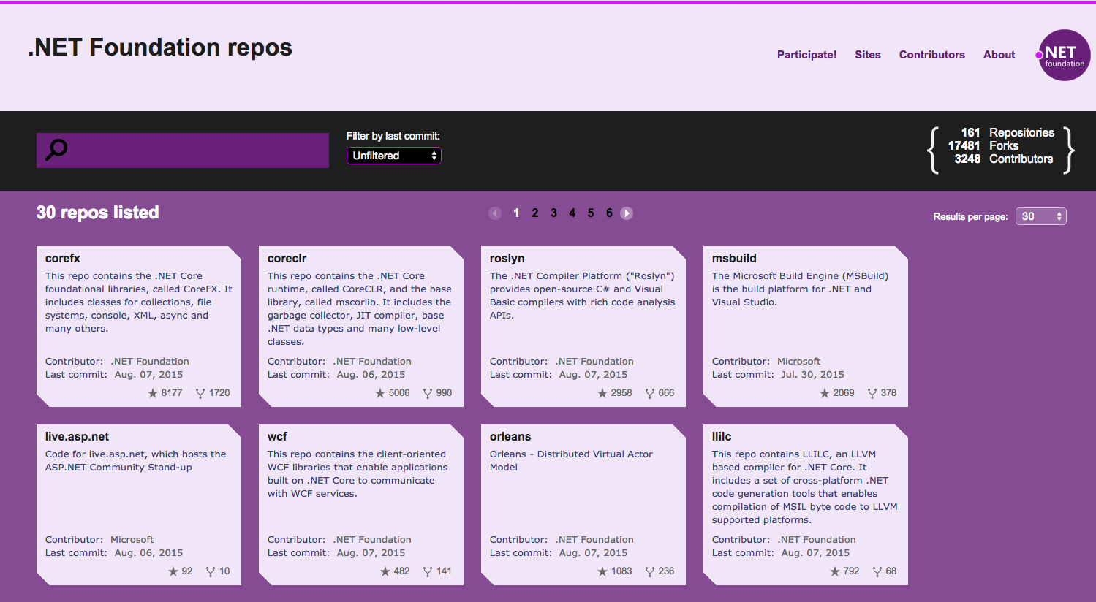

Slide 11
Running .NET on Linux the Easy Way

Slide 12
Docker Tools for Visual Studio 2015
Currently in preview
Separate install
http://aka.ms/VSDockerTools
ASP.NET 5 templates already part of VS 2015
Integrates well with Azure
Pushes to any Docker host

Slide 13
DEMO: Running ASP.NET on Linux with VS
Notes:
Create new ASP.NET 5 project in VS
Walk through Project.json
Look at Startup.cs
Look at project settings
Expand references in solution explorer
Show off publish wizard
Move to VS Project already running on Azure
Launch site in browser
Here let’s hop over to the Linux VM
Run the ASP.NET website (prev gen): MyFirstWebApp, dnx . kestrel
Go to the site in the browser: localhost:5000

Slide 14
Getting Setup

Slide 15
Getting the bits!
.NET Core already installed as part of VS2015
Curl DNVM
Curl DNVM
Docker
Clone repo on GitHub and build from source
Install from CMD/PS
Install a DNX
Optionally install Mono
Install prereqs
Install a DNX
Optionally install Mono
Development/Deployment
Development

Slide 16
Installing on OS X
Install Visual Studio Code
Install asp.net from http://get.asp.net
OR
curl -sSL https://raw.githubusercontent.com/aspnet/Home/dev/dnvminstall.sh | DNX_BRANCH=dev sh && source ~/.dnx/dnvm/dnvm.sh
Dnvm upgrade –r coreclr

Slide 17
Installing on Linux
Optionally install Mono //More on this later
Install and build libuv
Install DNVM //Much more on this later
http://aka.ms/AspNetOnLinux
http://aka.ms/DotNetSettingUpLinux

Slide 18
Kestrel
Cross platform Web Server
Built using Libuv (same as Node)
Libuv is an async IO library
Open Source
https://github.com/aspnet/KestrelHttpServer
You can run / write your own web server
IIS / WebListener also work
http://aka.ms/aspnet5servers

Slide 19
Creating an App

Slide 20
Dev Environment Options
Visual Studio 2015
Visual Studio Code
Visual Studio Code
Visual Studio Code
Choose your favorite editor, e.g. Sublime Text, Atom, etc.
Choose your favorite editor, Vi, Emacs, Atom, etc.
http://omnisharp.net

Slide 21
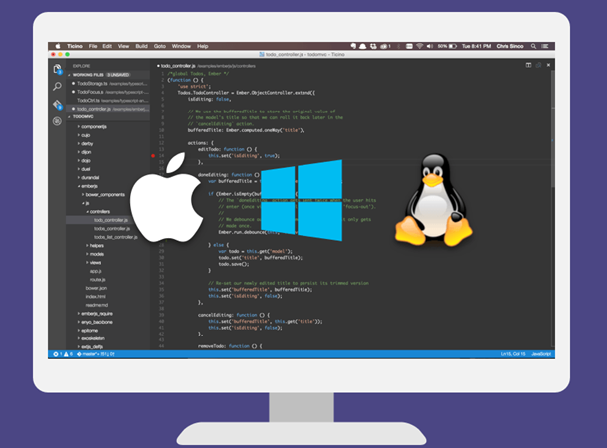
Visual Studio Code
Lightweight, cross-plat editor that runs on Windows, OS X and Linux
Provides IntelliSense, colorization, refactoring, etc.
Edit, compile, and run apps locally
Debugging support for .NET apps (sort of ;))
Open source
Support for extensions

Slide 22
Yeoman
Scaffolding tool for apps
Installed with NPM
Makes creating new projects super easy!
yo aspnet
Generators installed with npm

Slide 23
DEMO: Creating a Console App
Notes:
Go to OS X
Run DNVM – explain listing out the versions of the framework
Explain why some are mono and some are not
Demonstrate pulling down the latest – “dnvm install latest”
Demonstrate pulling down latest unstable – “dnvm install latest –u”
Install coreclr x64 version of latest – “dnvm install latest -r coreclr –arch x64 –u”
Run “yo aspnet”
Create console app
Highlight commands
Open in VSCode
Dnu restore
Dnu build
Dnx . Run
Switch to coreclr (dnvm upgrade –r coreclr)
Run again

Slide 24
What’d we just see?
Dnvm - .NET Version Manager
Dnu - .NET Development Utility
Dnx - .NET Execution
Yo – yeoman
Building for Mono and CoreCLR
Notes:
DNX - .NET execution – provides xplat runtime host to build .NET Core based apps
DNX451 - .NET 4.5 Framework, dnxcore50 – minimal 5.0 subset
DNVM - .NET version manager – enables pulling down and upgrading to latest versions of .NET and Mono
DNU – deals with pulling down and installing packages for your applications
CoreCLR – small optimized runtime, distributed with app Mono

Slide 25
Running ASP.NET

Slide 26
DEMO: Building an ASP.NET App
Notes:
Go to Linux
Yo aspnet
Open project in VSC
Do a restore
Walk through files
Dnu build
Dnx . kestrel

Slide 27
Debugging and Unit Tests

Slide 28
Debugging
Doesn’t work out of the box
Can work with Mono
Requires creating build task using xbuild and creating EXE
Possible for ASP.NET but more complex
Built-in to VS Code coming
Working with CoreCLR coming

Slide 29
Unit Testing
Unit test project in Yeoman
Add new command
Add dependencies
Add test class(es)
Dnx test

Slide 30
DEMO: Debugging and Unit Tests
Notes:
Go to Linux
Yo aspnet
Open project in VSC
Do a restore
Walk through files
Dnu build
Dnx . kestrel

Slide 31
Deployment, Advanced, Misc

Slide 32
Deployment
Xcopy deployment to target environment
On-premises, IaaS, Docker, etc
Deploy .NET Core with app
No system wide installation necessary
Package in Docker in VS

Slide 33
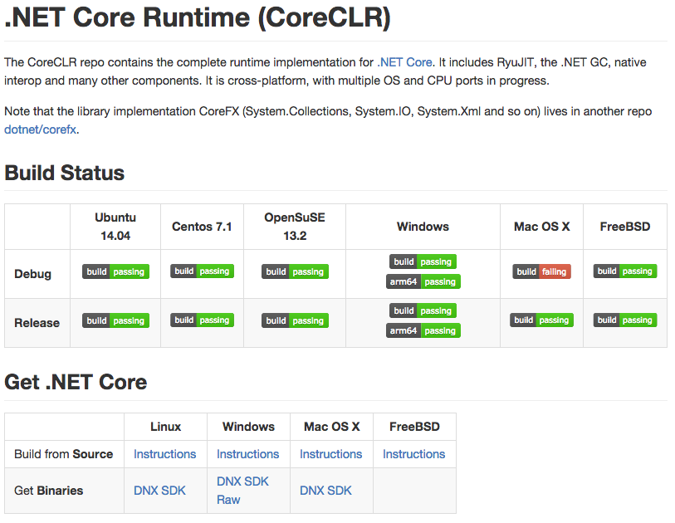
.NET Core On GitHub

Slide 34
Calling Native Code
[DllImport("libc")]
private static extern int printf(string format);
…
printf("Hello, //Codemash 2016!\n");
// Same as PInvoke on Windows

Slide 35
Setting the Environment
Windows:
set ASPNET_ENV=Development
OS X / Linux:
export ASPNET_ENV=Development
(also Staging, Production)

Slide 36
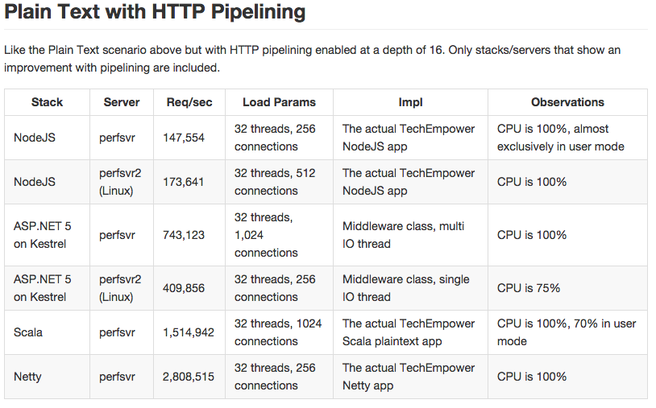
Performance
https://github.com/aspnet/benchmarks

Slide 37
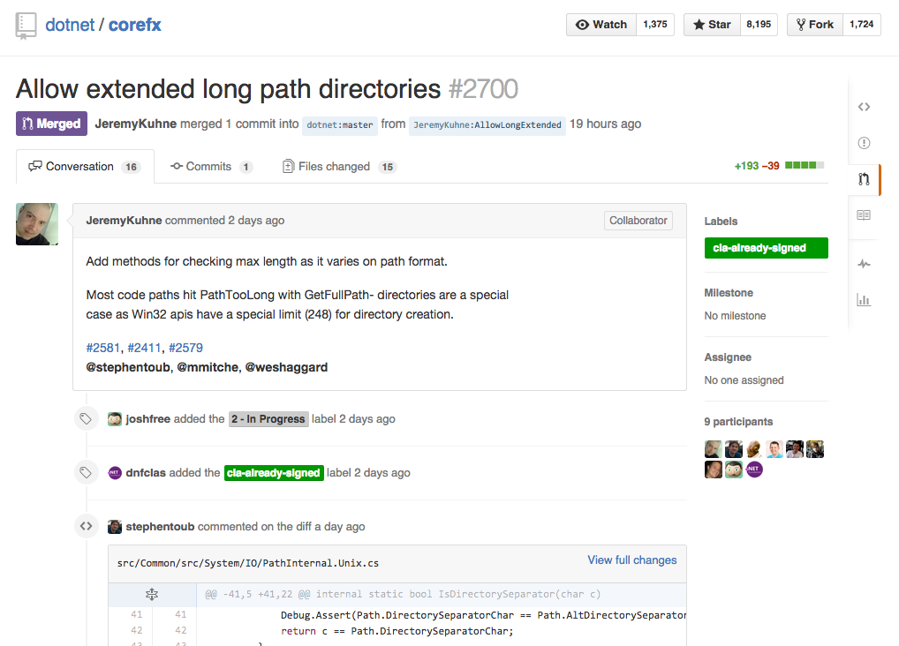
Notes:
Max Path fix for .NET

Slide 38
DEMO: SQL
Notes:
Go to Linux
Yo aspnet
Open project in VSC
Do a restore
Walk through files
Dnu build
Dnx . kestrel

Slide 39
Wrapup

Slide 40
Today
Install Visual Studio 2015 on Windows
Manual installs on OS X / Linux
Pre-built VM on Azure Marketplace
Docker using dockerfile

Slide 41
What’s coming?
Remote debugging in VS2015
Local debugging in VS Code
Performance improvements
More libraries ported to .NET Core
.NET Native
dotnet CLI

Slide 42
Prepping your Apps
Creating a new app
Start with VS 2015 ASP.NET 5 templates
Check out PartsUnlimited sample on GitHub
Moving existing apps
Transition to ASP.NET 5 on Windows

Slide 43
Go Live!
Production approved
Engage directly with teams on GitHub
http://aka.ms/NetCoreSupport

Slide 44
MICROSOFT SESSIONS
Day | Room | Event | Speaker
Thu 8:00AM | Salon E | The Hitchhiker's Guide to Azure Mobile Apps | David Giard
Fri 4:00PM | Aloeswood/Leopardwood | Secrets of Success in the style of GLEE | Jennifer Marsman
Thu 9:15AM | Mangrove | Something has Frozen Over: .NET on Linux and OS X | Chris Risner
Thu 9:15AM | Salon A | Designing a Game for Mobile | Amanda Lange
Thu 11:45PM | Salon A | Rise of the Machines | Josh Holmes
Fri 4:00PM | Orange | Cloud-Scale Event Processing with the Reactive Extensions (Rx) | Matthew Podwysocki
Thu 10:30AM | Zambezi | Designing C# 7 in the Open | Kevin Pilch-Bisson
Fri 9:45AM | Aloeswood/Leopardwood | Big Data for the SQL Ninja | Matt Winkler
Thu 3:30PM | Zambezi | Cloud Design Patterns for Scalability and Performance | Matt Johnson
Thu 1:00PM | Guava/Tamarind | Getting Started with nuML, an Open Source .NET Machine Learning Library | Seth Juarez
Thu 9:15AM | Salon H | Tracking Real World Web Performance | Nik Molnar
Thu 9:15AM | Sagewood/Zebrawood | The Code Behind the Vulnerability | Barry Dorrans
Thu 1:00PM | Sagewood/Zebrawood | Introducing the new ASP.NET Authorization and Data Protection Stacks | Barry Dorrans

Slide 45
MVP SESSIONS
Day | Room | Event | Speaker
Tue 1:00PM | Salon A | Cross Platform Mobile UI with Xamarin Forms Workshop | Jason Awbrey
Wed 8:00AM | Aloeswood, Leopardwood | Tune SQL Server Like a Guru! – Part 1 | Kevin Boles
Wed 11:45:AM | Cypress | Async Everywhere! | Stephen Cleary
Wed 11:45:AM | Aloeswood, Leopardwood | Abstract Art: Getting Abstraction “Just Right” | Jeremy Clark
Wed 1:00PM | Aloeswood, Leopardwood | Tune SQL Server Like a Guru! – Part 2 | Kevin Boles
Thu 8:00AM | Nile | CQRS 2.0 | David Hoerster
Thu 8:00AM | Zambezi | Node.js Crash Course | David Neal
Thu 10:30AM | Sagewood, Zebrawood | Whose Shoulders are These? | Jack Daniel
Thu 10:30AM | Orange | Bringing Up Our Future – On Mentoring Junior Developers | Sarah Dutkiewicz
Thu 10:30AM | Indigo Bay | Consuming REST APIs, for all interpretations of REST | Darrel Miller
Thu 10:30AM | Salon A | A Look at Team Foundation Server 2015 Build | Paul Hacker
Thu 11:45AM | Indigo Bay | Common TSQL Mistakes | Kevin Boles
Thu 1:00PM | Aloeswood, Leopardwood | Growing a Testing^H^H^H^H^H^H^HWhole Quality Team The Hard Way | Jim Holmes
Thu 1:00PM | Salon D | Getting Started with 3D Printing | Adam Barney
Thu 1:00PM | Salon A | Hypermedia APIs: The rest of REST | Chris Marinos
Thu 3:30PM | Suite 1, Suite 6 | Why I Left Angular and Knockout for React | Cory House
Thu 3:30PM | Aloeswood, Leopardwood | Load Testing Your Web Application in Visual Studio: A Case Study | James Bender
Fri 9:45AM | Salon D | Electronics 101 for IoT Developers | Adam Barney
Fri 9:45AM | Salon E | Convention Over Configuration: Queueing is Easy | Matthew Groves
Fri 9:45AM | Suite 1, Suite 6 | “OMG! This Codebase Sucks!” Paying Down Technical Debt While Continuing to Deliver Value | Jim Holmes
Fri 9:45AM | Mangrove | XAML & C# Powered iOS, Android, and Windows apps | James Montemagno
Fri 12:15PM | Zambezi | ECMAScript 2015 & JavaScript – Don’t Get Left Behind | Jared Faris
Fri 4:00PM | Indigo Bay | Cross-Platform Desktop Apps with Electron | David Neal

Slide 46
Resources
@ChrisRisner
http://chrisrisner.com
http://code.visualstudio.com
http://github.com/aspnet/home
http://docs.asp.net
http://get.asp.net
http://live.asp.net
https://github.com/Microsoft/HealthClinic.biz/
Notes:
https://code.visualstudio.com/Docs/ASPnet5 – running aspnet in both locations
Install DNVM to Ubuntu - https://github.com/aspnet/Home/blob/dev/GettingStartedDeb.md
Getting started with linux: https://github.com/aspnet/home#linux
ASP.NET docs - http://docs.asp.net/en/latest/getting-started/index.html

Slide 48
Docker file
FROM microsoft/aspnet:1.0.0-rc1
COPY . /app
WORKDIR /app
RUN ["dnu", "restore"]
EXPOSE 5000/tcp
ENTRYPOINT ["dnx", "-p" "project.json", "web"]

